Slide 1


SAP UI5 & FIORI with OData TRAINING using BAS
Anubhav Oberoy
Day – 8

Slide 2

Agenda – Day 8
What is Fiori?

Slide 3
Resource Model
We build software for international audience, we cannot just hardcode every screen element in English, if it requires multi-lingual support, we need to add resource model.
i18n → Internationalization
There are 2 job roles in the process:
Language Expert KM
UI5 Consultant
?sap-ui-language=hi
Implement the model to provide support for internationalization
Translate the texts to provide support in multiple languages
I18n.properties
TEXTS
Language specific

Slide 4
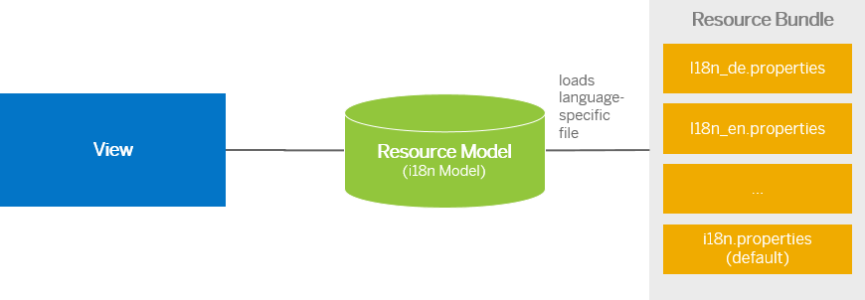
Steps to Create a Resource Model
Create resource bundle which includes label field
The name of the file must be i18n.properties for default labels
And i18n_langcode.properties for different languages
Set The model
For more information about i18n you check the link
https://openui5.hana.ondemand.com/1.34.9/docs/guide/831039835e7c4da3a8a0b49567573afe.html
We can change the language of the app by adding ?sap-language=language_code at the end of the URL of the app. Example for Hindi we will write ?sap-language=hi

Slide 5

Exercise: Resource Model
In this exercise we will see how the language of an app is changed using the i18n file.
We have to create a folder ‘i18n’ in webapps folder and in the folder, we have to add files named ‘i18n.properties’ and one another file named according to the language we want. For example:- for Hindi language the file is named as ‘i18n_hi.properties.
Along with that we will add a delete button on top of the table to delete the record of an employee from the model.
Exercise Code:-
MyView.view.xml
MyView.controller.js
i18n.properties
i18n_hi.properties

Slide 6
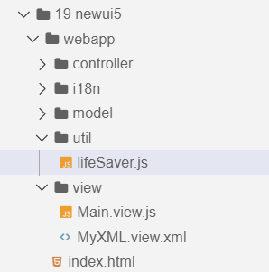
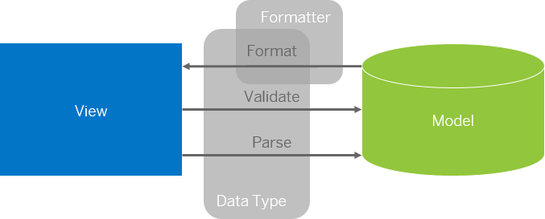
Formatter in SAP UI5
Formatters are used to define the formatting of data on the UI while data types work in both directions: they format the data on the UI and parse and validate user input that is entered.
Formatter is a function; This function gets called JUST Before the binding takes place with the view.
Formatter file is placed in a folder in webapp folder, and the file can be named anything with the .js extension.
Formatter

Slide 7

Exercise: Formatter
In this exercise we are going to currency code in the table.
We will convert the currency code into its corresponding currency symbol.
We will achieve this by using a formatter function.
Exercise Code:-
MyView.view.xml
MyView.controller.js
lifeSaver.js

Slide 8
Title
Content

Slide 9
Title
Content

Slide 10
Title
Content

Slide 11
Title
Content

Slide 12
Title
Content

Slide 13
Title
Content

Slide 14
Title
Content

Slide 15
Title
Content

Slide 16

End of Day 8

Slide 17

Questions

Slide 18

Anubhav Oberoy

Slide 19


We’re committed to empower you to be
Most Desirable Resource
through powerful training solutions.
We build the workforce of the future.
250+
Corporate Clients
30,000+
Learners Trained
25000+
Learners Placed
FREE WEBINARS
Sign up for free webinars with industry experts every fortnight!
Enroll Now!
Contact us today!
https://anubhavtrainings.com/

Slide 20




More from AnubhavTrainings.com

Slide 21
Title
Content

